Slide 1

Guru Ghasidas Vishwavidyalaya
Bilaspur (C.G.)
Department of Computer Science and Information Technology
“ AI – Powered Resume Builder ”
Submitted by:
Sanjana Giri
MCA 4th Sem
Enrollment No: GGV/23/05043
Roll No.:23072155
Guided by:
Dr. Sushma Jaiswal
Assistant Professor

Slide 2

Agenda
Introduction
Project Overview
AI Integration
Architecture
How it Works Flow
UI Preview
Conclusion
Future Enhancements

Slide 3

Introduction
In today’s competitive job market, a well-crafted resume is critical to making a strong first impression. However, many job seekers face challenges such as lack of design skills, unclear formatting, and time-consuming manual editing.
To address these issues, our project introduces an AI-Powered Resume Builder—a smart, user-friendly platform that simplifies the resume creation process using modern technologies and artificial intelligence.
Objective:-
Simplify and enhance the resume-building process.
AI-powered tools assist in creating professional resumes.
Aims to make the resume-building process faster and more effective.

Slide 4


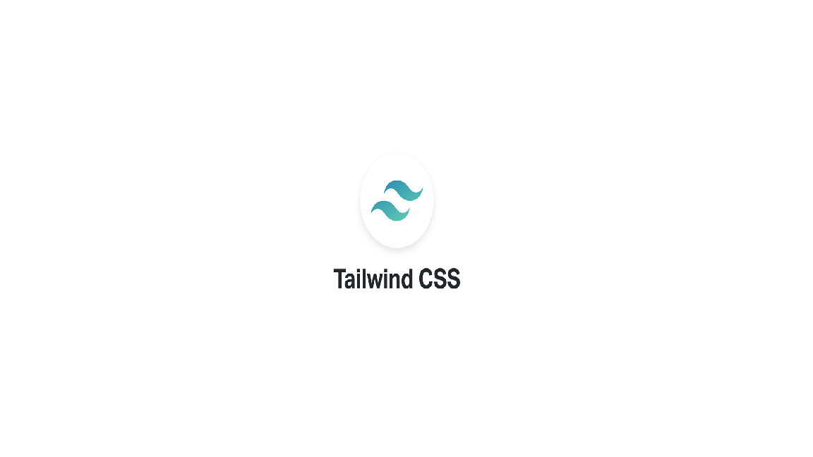
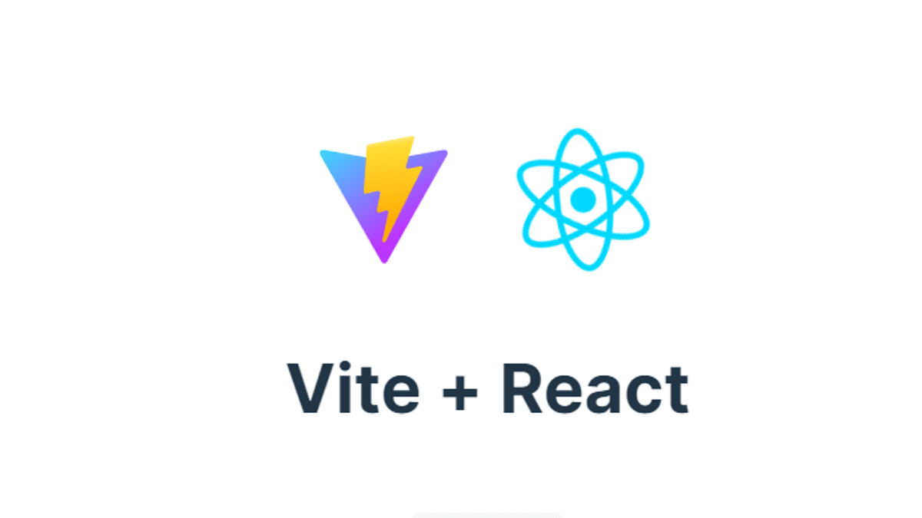
Project Overview
Technologies Used and Core Functionalities

Slide 5
Project Overview
Tech Stack:
Frontend :-
React: A popular JavaScript library used to build the dynamic user interface of the app.
Vite: A fast build tool and development server that improves performance during development.
Styling:-
Tailwind CSS: A utility-first CSS framework that allows for fast and responsive styling.
Backend:-
Strapi: A headless CMS used to manage backend data such as user details, resume content, and more.
Database:-
PostgreSQL: A powerful open-source relational database used to store user data securely.
Authentication:-
Clerk: An authentication service that manages user sign-up, login, and session management.

Slide 6
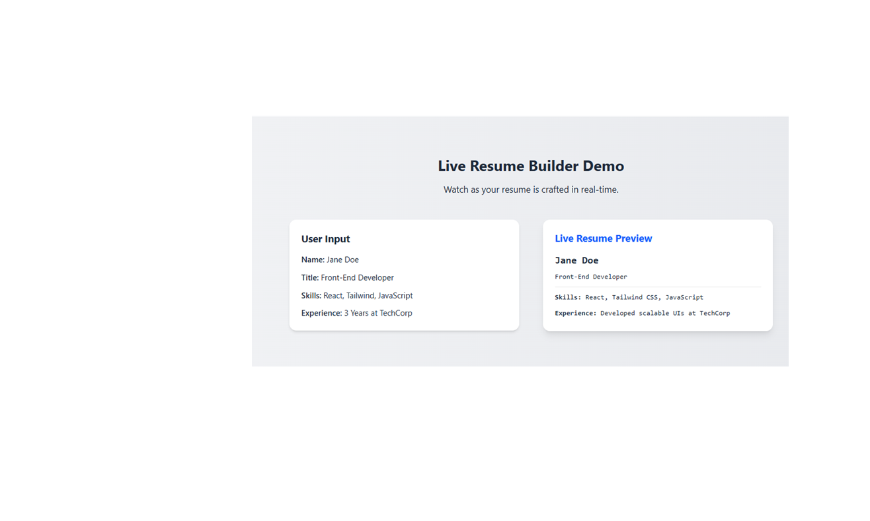
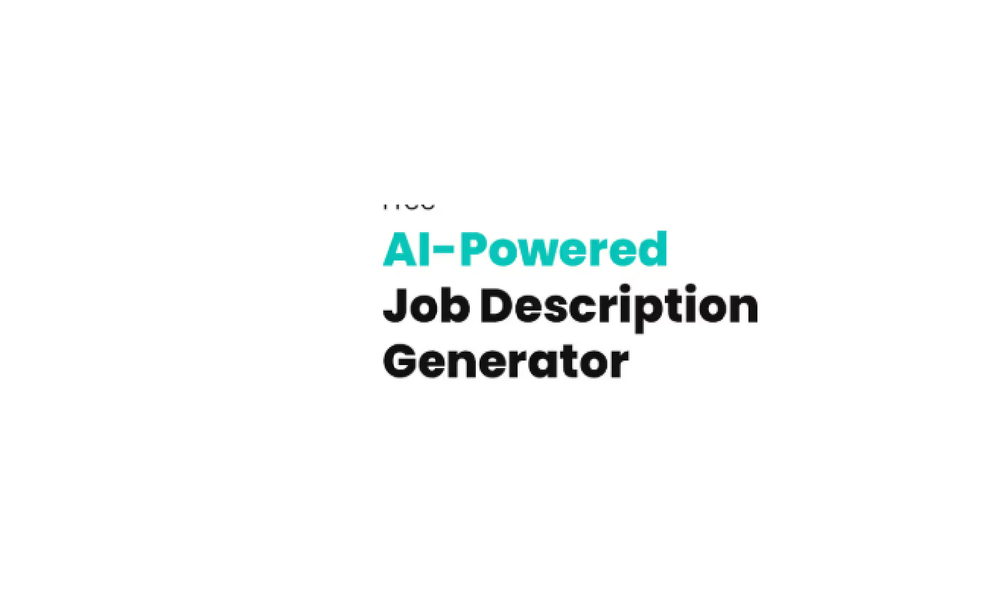
Features:-
AI-powered profile summary , job summary suggestions using Gemini AI (Google Generative AI)
User-friendly form sections for:
Personal Details
Experience
Education
Skills
Live Resume Preview with a clean and modern layout

Slide 7

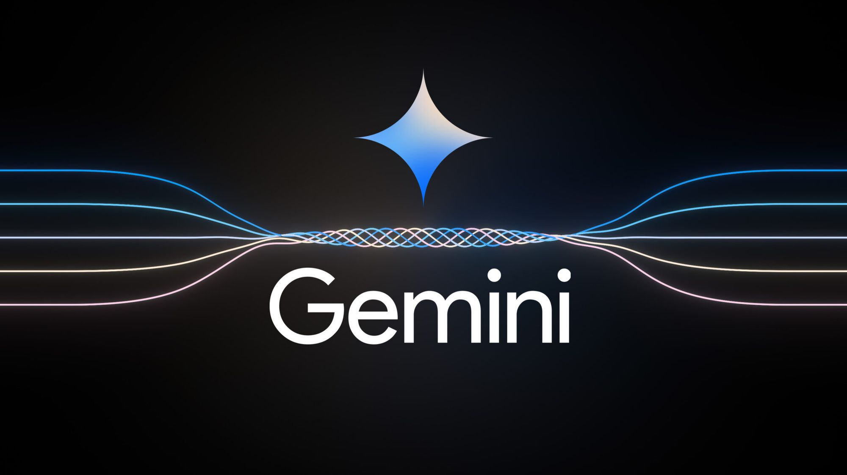
AI Integration
Gemini AI (Google Generative AI) is used to enhance resume quality.
It analyzes user input (like job role or experience) to generate:
Personalized job summaries
Skill suggestions (if implemented)
Professional tone and structure
Real-time interaction with the frontend using REST APIs.
Improves user productivity by reducing writing effort.
Adds intelligence and adaptability to the resume-building experience.

Slide 8
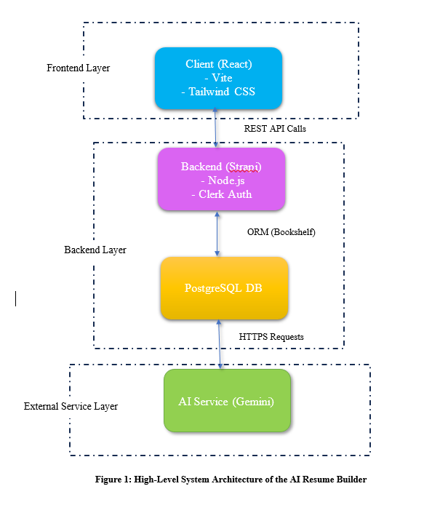
Architecture
System Design and Technology Integration
Frontend Layer:
Backend Layer:
Database Layer:
External Service Layer:

Slide 9
Frontend Layer:
Built with React, Vite, and Tailwind CSS.
Handles the user interface and sends REST API calls to the backend.
Backend Layer:
Uses Strapi (a Node.js-based CMS) to manage and expose content via APIs.
Integrated with Clerk for secure user authentication and session management.
Communicates with the PostgreSQL database through an ORM (Bookshelf).
Database Layer:
PostgreSQL stores user data, resume content, and form inputs.
Ensures reliable and structured data storage.
External Service Layer:
Connects to Gemini AI (Google Generative AI) via HTTPS Requests.
Used to generate smart and personalized job summary suggestions for users.

Slide 10
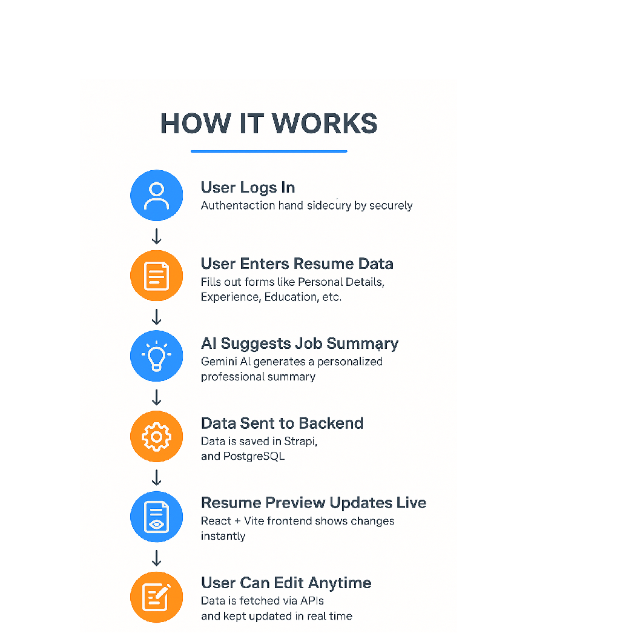
How It Works – Workflow
User Logs In ➤ Authentication handled securely by Clerk.
User Enters Resume Data ➤ Fills out forms like Personal Details, Experience, Education, etc.
AI Suggests Job Summary ➤ Gemini AI generates a personalized professional summary.
Data Sent to Backend ➤ Data is saved in Strapi, and stored in PostgreSQL.
Resume Preview Updates Live ➤ The React + Vite frontend shows changes instantly.
User Can Edit Anytime ➤ Data is fetched via APIs and kept updated in real time.

Slide 11
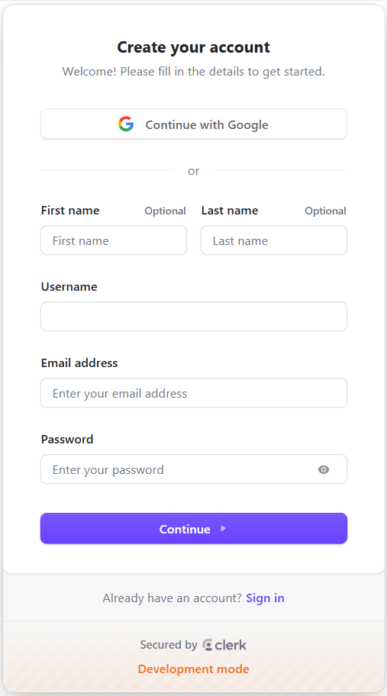
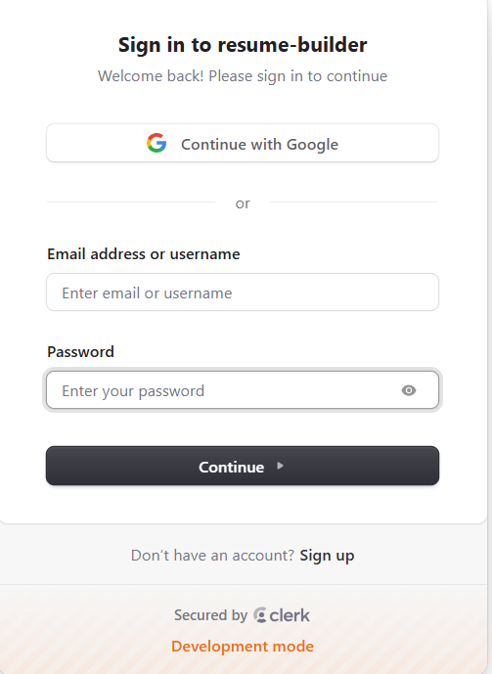
UI Preview
Login page:-
Sign up page −
Sign in page −

Slide 12
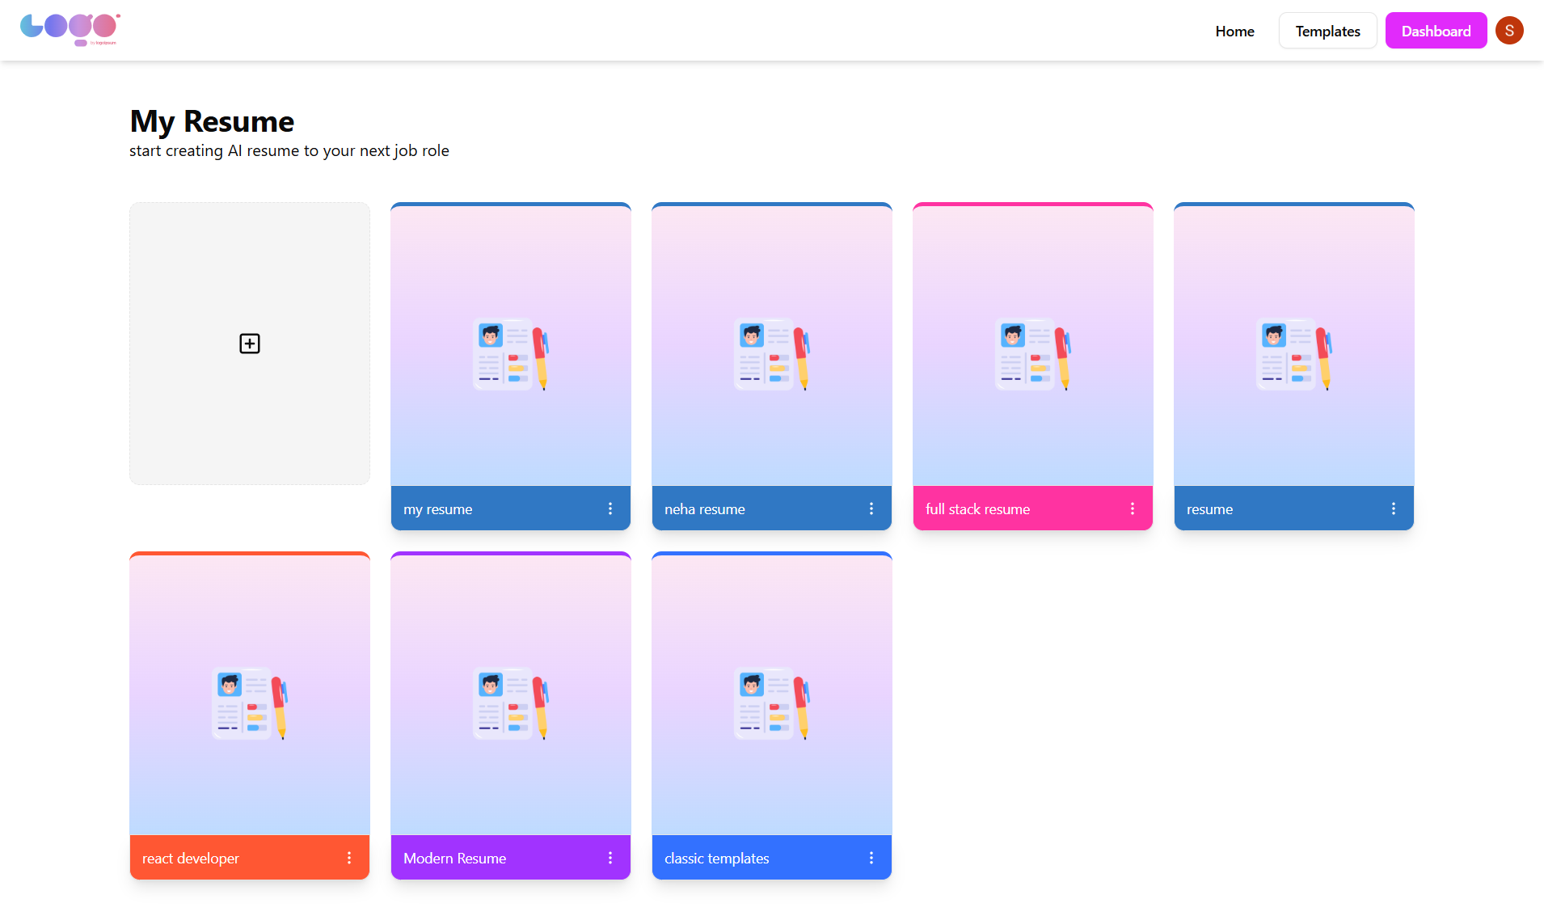
Dashboard page
The Dashboard allows users to start building a new resume and conveniently access their previously created resumes in one place.

Slide 13
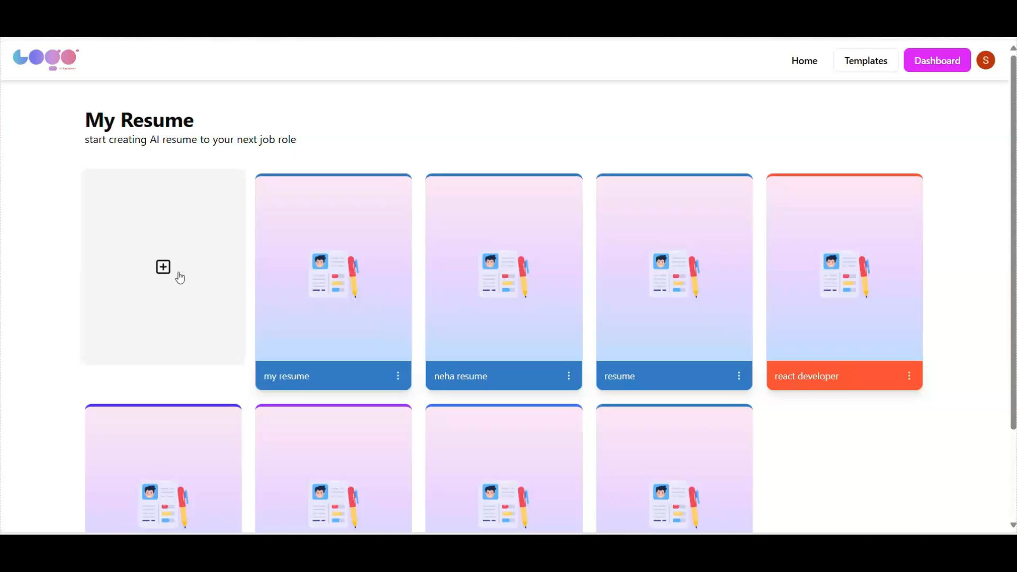
📄 Live Resume Preview ➤
Show the real-time rendered resume
🧠 AI Job Summary Generator ➤ Generate personalized job summaries instantly with Gemini AI

Slide 14
Conclusion
The AI Resume Builder simplifies resume creation with an intuitive interface and smart automation.
Integrating Gemini AI ensures users get professional, tailored summaries effortlessly.
A modern tech stack (React, Strapi, PostgreSQL, Clerk) powers a seamless and secure experience.
The live preview and section-based editing improve user control and resume quality.
Ideal for students, professionals, and job seekers who want to save time and stand out.

Slide 15
Future Enhancements
Real-time Job Matching
Integrate with job boards (e.g., LinkedIn, Indeed) to match resumes with live job listings.
Dynamic Resume Customization
Allow users to dynamically adjust their resume for different job types by selecting a "target" role and adjusting content accordingly.
Voice Input for Resume Creation
Implement voice-to-text functionality to allow users to dictate their resume details.
LinkedIn Integration
Auto-import profile data or sync resume updates directly to LinkedIn.
Mobile App Version
Provide on-the-go editing and preview capabilities via iOS/Android apps.

Slide 16
Thank You

